Slide 1
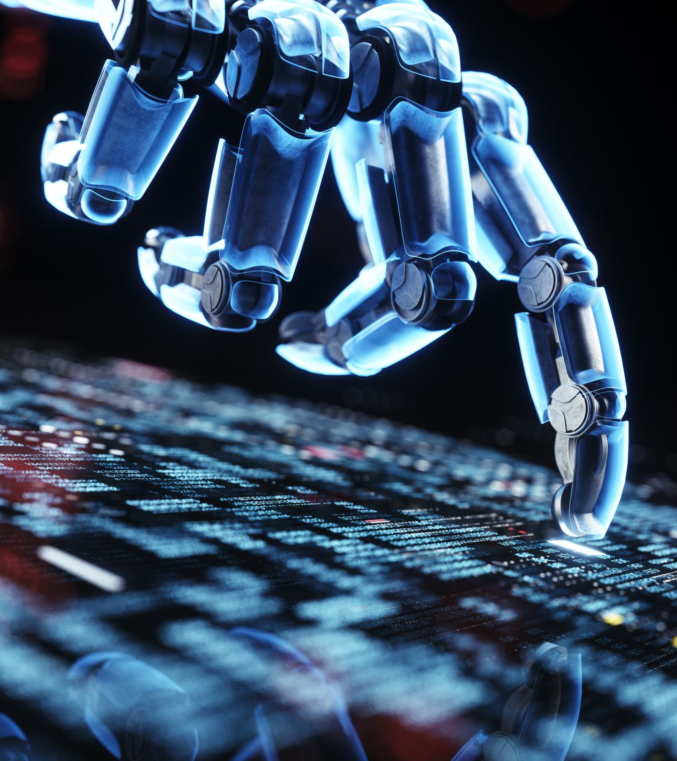
Machine Learning and AI for Productivity

Slide 2

Content
Define Machine Learning (ML)
Insight into ML
Define Artificial Intelligence
Concrete Examples of how Machine Learning and AI can enhance productivity in the Health Space

Slide 3

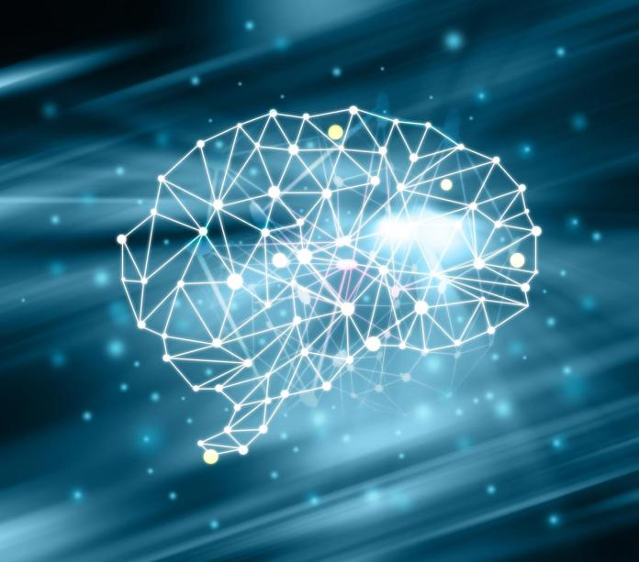
What is Machine Learning?
Machine learning is the process of giving computers the ability to learn without being precisely programmed.
This Photo by Unknown author is licensed under CC BY.

Slide 4
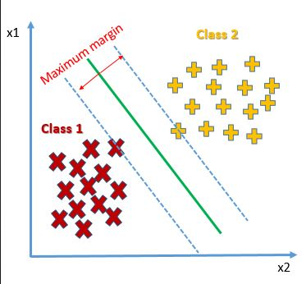
Example of a Machine Learning Model

Slide 5

What is Artificial Intelligence ?
The ability of a computer or machine to mimic intelligent human behavior. This includes things like understanding natural language, recognizing objects, and making decisions.

Slide 6
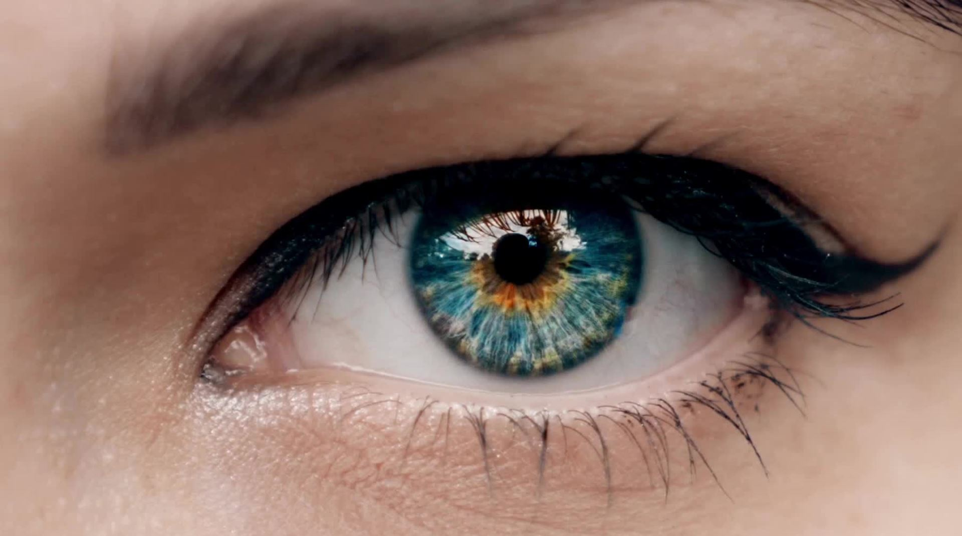
ML-backed AI model - Example
ML algorithms can be trained on massive datasets of retinal images to identify subtle patterns and abnormalities that may indicate the presence of eye diseases like diabetic retinopathy or age-related macular degeneration.

Slide 7
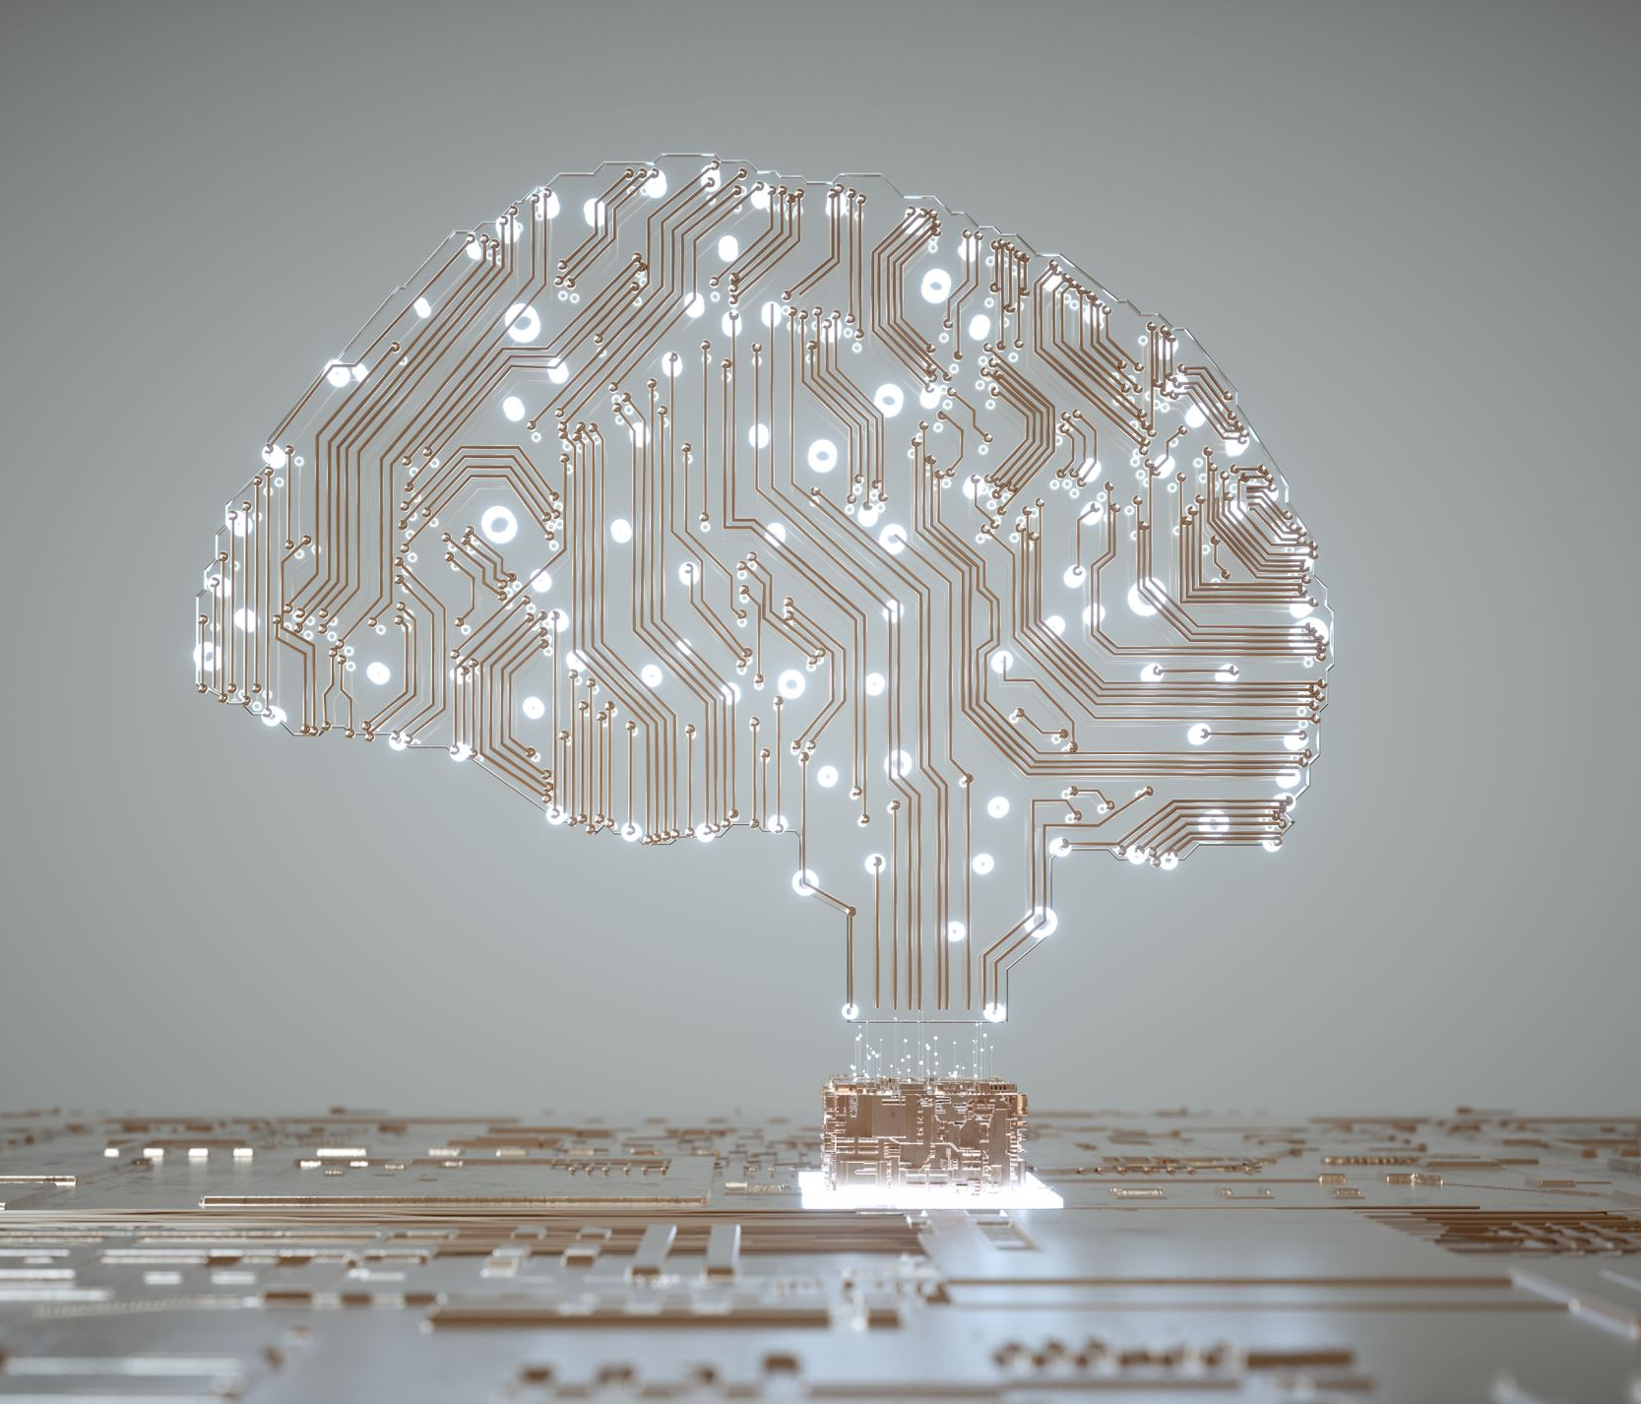
ML and AI
AI is the broader concept of creating intelligent machines, while ML is a specific technique that can be used to achieve this goal

Slide 8
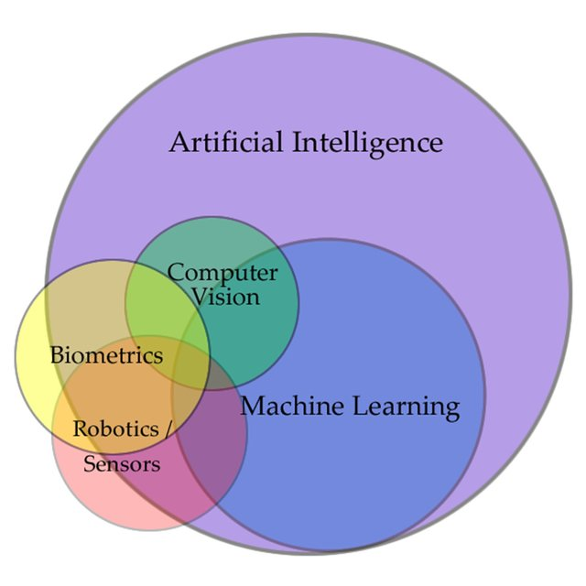
ML is a subset of AI

Slide 9

Using AI/ML to Improve Productivity in the Health Space
Concrete Examples

Slide 10
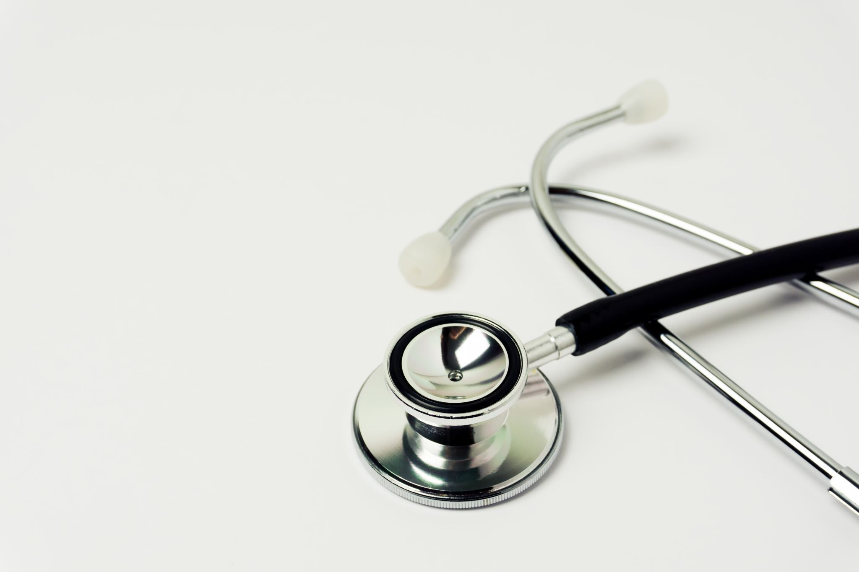
Data Analysis and Patient Segmentation for Chronic Disease Management
Employ machine learning to segment patient population based on demographics, health conditions, and healthcare utilization.
The insights gained from patient segmentation can inform clinical decisions, such as resource allocation by the HMO, and preventive care planning.

Slide 11

Predictive Modeling for Health Risks
Develop a machine learning model to predict the risk of cardiovascular disease (CVD) for individuals based on various health-related factors.
This example illustrates how machine learning can be applied to proactively identify health risks, allowing for early intervention and personalized healthcare strategies to mitigate the risk of specific diseases

Slide 12

Monitoring surveillance footage
Machine learning and artificial intelligence play a crucial role in fire detection by analyzing patterns in sensor data to swiftly identify potential fire hazards. These technologies enable predictive modeling to anticipate fire outbreaks based on historical data, enhancing early warning systems. Additionally, ML/AI algorithms can automate the process of monitoring surveillance footage or satellite imagery for signs of smoke or heat anomalies, allowing for rapid response and mitigation measures

Slide 13
Automated Prior Authorization Review
Prior authorization is a common requirement for certain medical procedures, medications, and equipment. The process of reviewing prior authorization requests can be time-consuming and manual, often involving multiple staff members and multiple systems
Reduce processing time: ML can review requests much faster than manual review, significantly reducing the time it takes to process requests

Slide 14

ML/AI powers language transformers
ML/AI powers language transformers by training models to understand and generate human-like text efficiently. These transformers, such as GPT, excel in tasks like translation, summarization, and text generation, enabling diverse applications from chatbots to content creation.

Slide 15

Automated diagnosis
ML algorithms can analyze medical images, such as X-rays, CT scans, and MRIs, to identify abnormalities and potential diagnoses.
This technology is particularly useful in areas like radiology, dermatology, and ophthalmology, where visual inspection of images is crucial.

Slide 16
Fraud Detection and Claims Management
AI and ML can detect fraudulent activities and discrepancies in claims data, protecting HMOs' resources and ensuring that healthcare funds are used appropriately.
Unusual Billing Patterns: Frequency and types of procedures billed by providers.
Provider Behavior: Deviations from normal billing practices for a specific provider.
Patient History: Unusual patterns in patient claims, such as sudden spikes in utilization.

Slide 17

AI-Driven Kidney Health Monitoring and Prevention
IoT Devices and Wearables: Individuals use IoT devices and wearables to monitor key health parameters, including blood pressure, heart rate, hydration levels, and physical activity
Data Integration: Collected data is integrated into a centralized health monitoring platform.

Slide 18
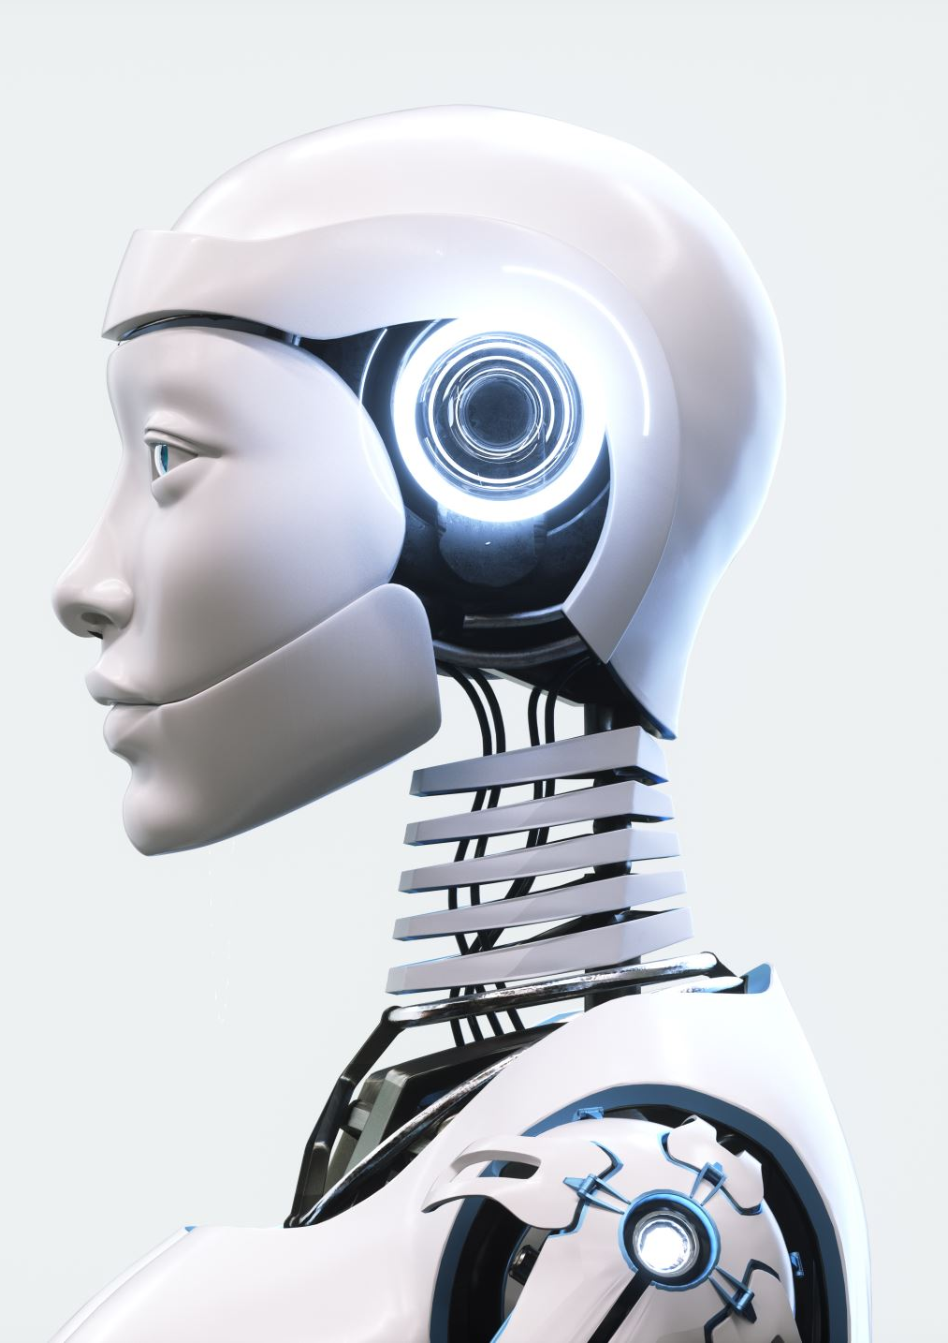
Mental Health Support and Personalized Interventions
AI and ML can provide personalized mental health support and interventions. AI-powered chatbots can offer emotional support, provide cognitive behavioral therapy (CBT) techniques, and connect patients with mental health professionals.

Slide 19
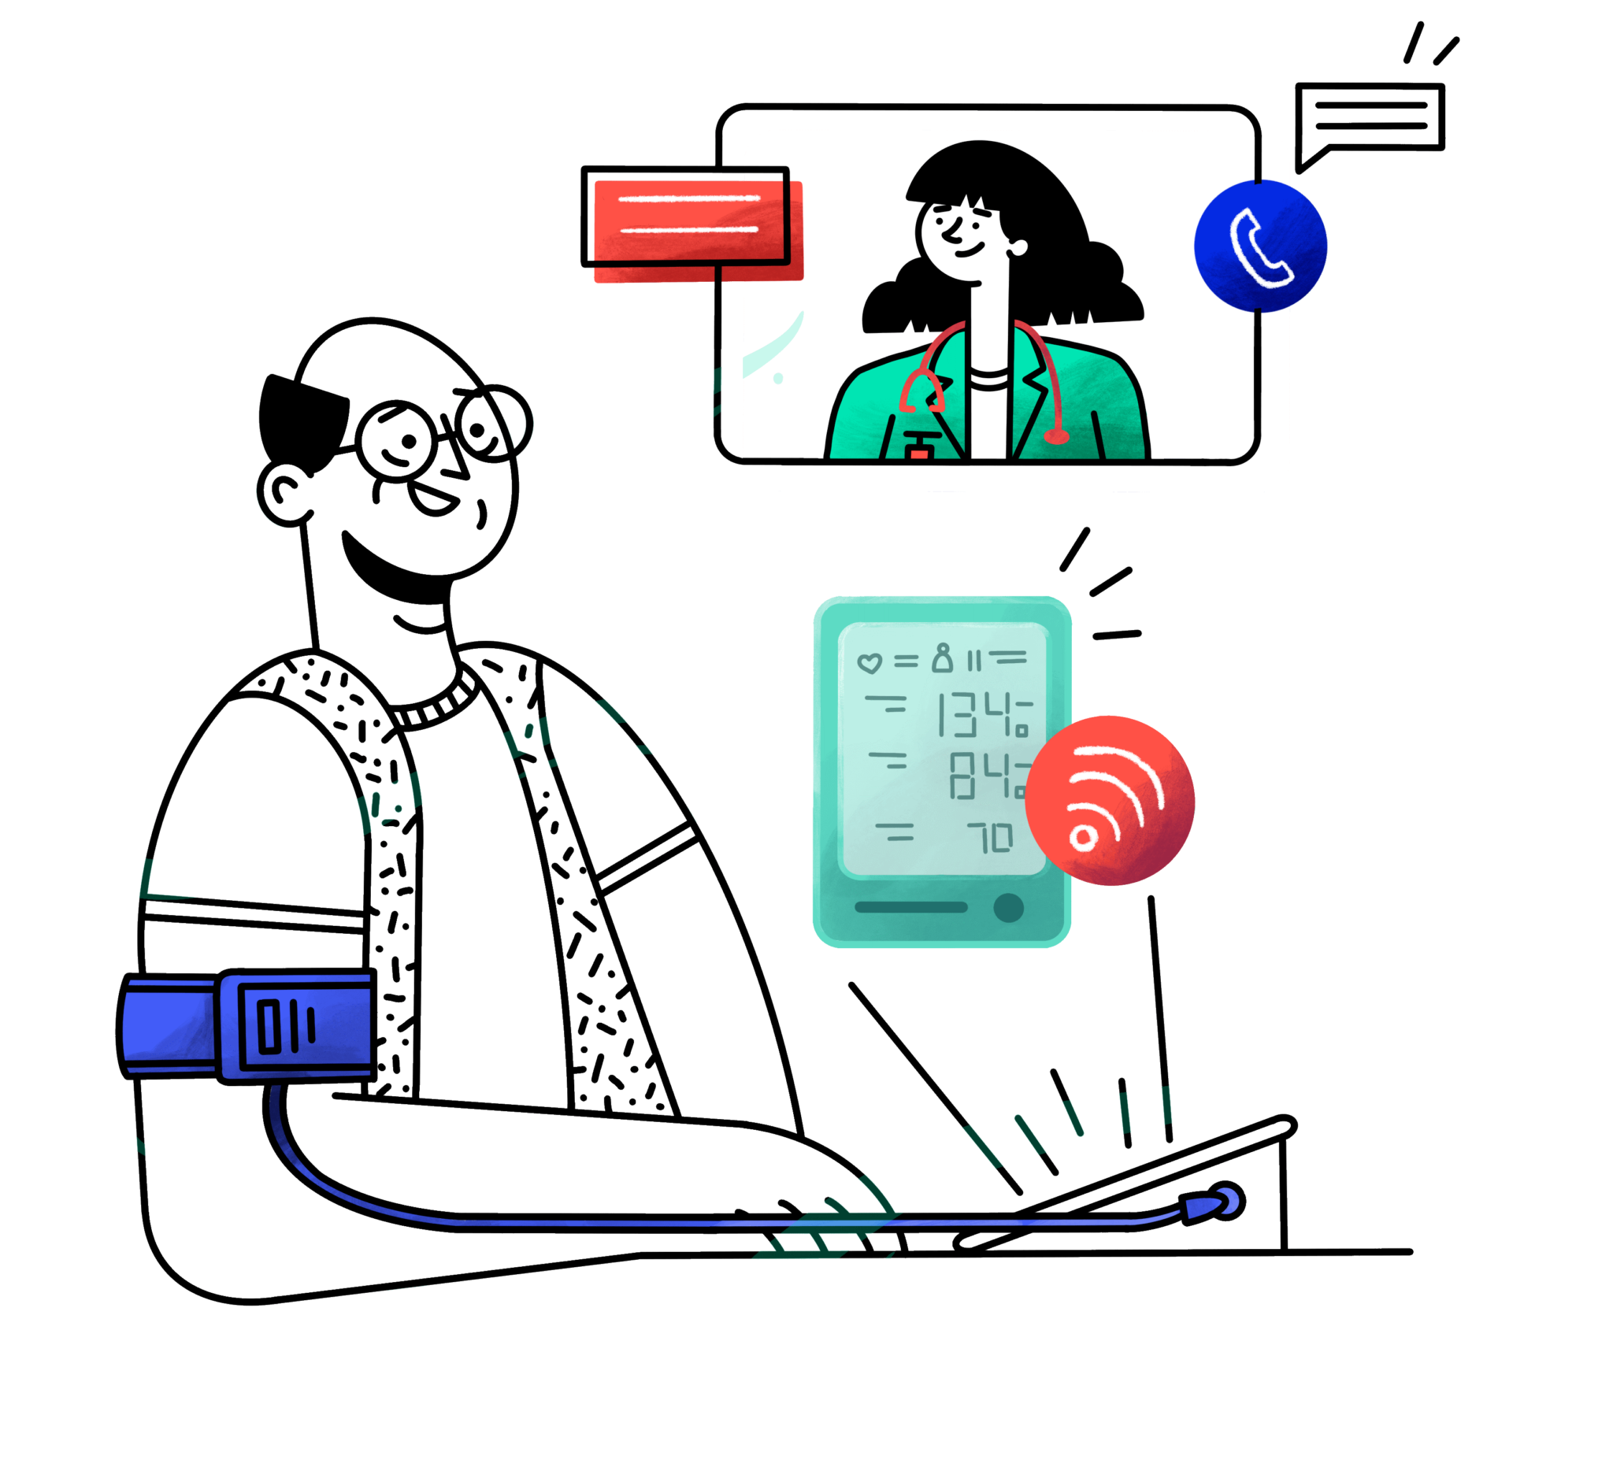
Remote Patient Monitoring
AI and ML can facilitate virtual health consultations and remote patient monitoring. AI-powered systems can analyze patient data, provide real-time feedback, and enable remote consultations with healthcare providers. This can improve access to care, especially for patients in remote or underserved areas.
This Photo by Unknown author is licensed under CC BY-NC-ND.

Slide 20
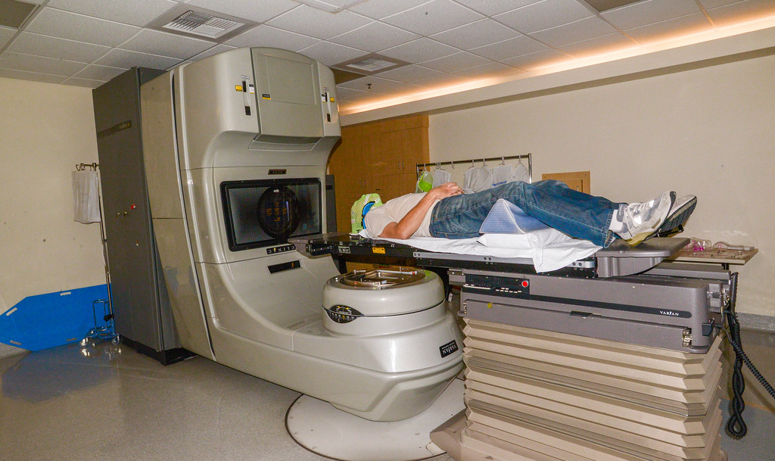
Machine Learning in Drug Selection for Cancer Treatment
This Photo by Unknown author is licensed under CC BY-SA.
Use machine learning to predict the effectiveness of different drugs for cancer treatment based on molecular and genetic information.
Personalized Treatment: The machine learning model assists oncologists in selecting drugs that are likely to be effective for individual patients based on their molecular and genetic profiles.
Improved Drug Selection: Enhances the efficiency of drug selection by considering a wide range of genomic information, leading to more personalized and targeted cancer treatments

Slide 21

Using ML and AI Identify Potential Flu Outbreaks
By analyzing data from multiple sources, HMOs can get a more comprehensive picture of the flu activity in their area.
This information can be used to make informed decisions about resource allocation, such as stockpiling flu vaccines or expanding flu testing clinics

Slide 22
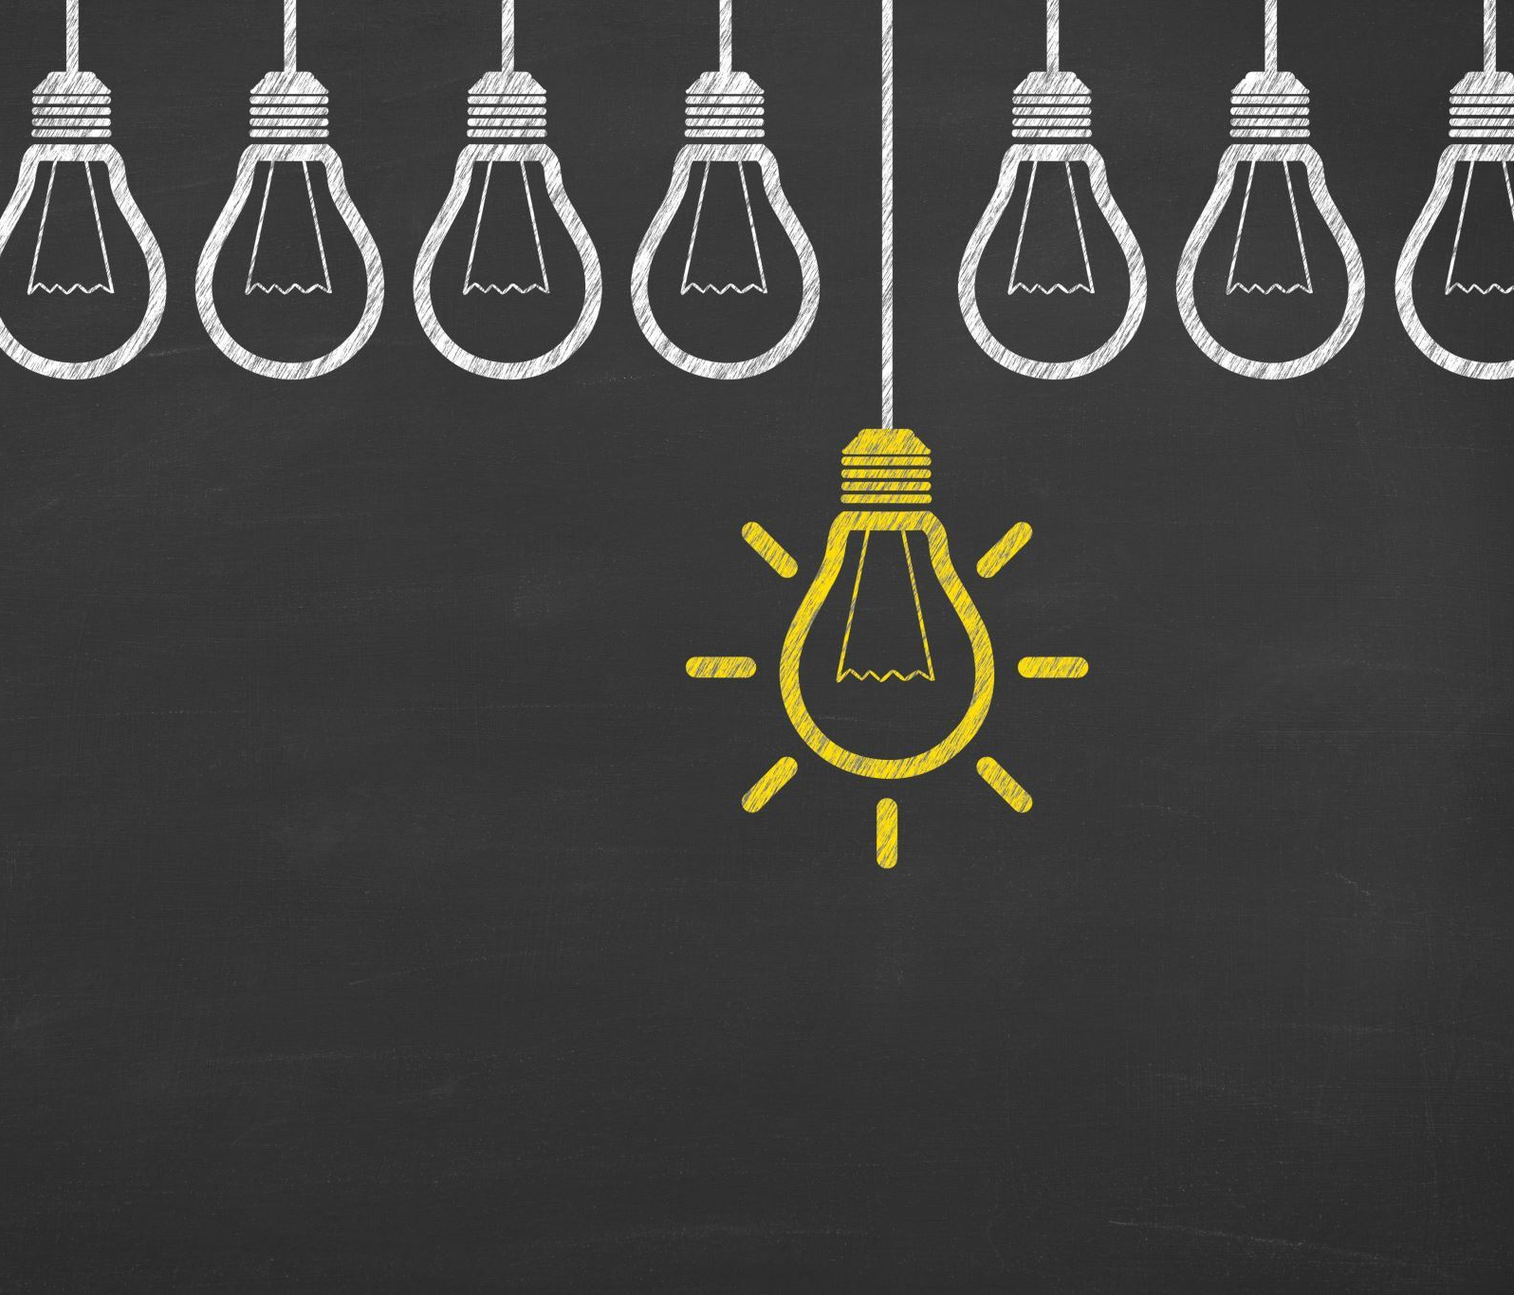
Generative AI for Medical Image Synthesis
In Nigeria, where access to a diverse range of medical images for training machine learning models might be constrained, generative AI can play a crucial role in addressing the scarcity of data.
In situations where sharing real patient data is challenging due to privacy concerns, synthetic data can be shared without compromising patient privacy.

